Slide 1
Bike Sharing Demand Project
Meeting 25.08.2017

Slide 2
Bike Sharing Demand
Introduction
General information

Slide 3
Introduction
Project was composed of 2 parts
Data Science
Apache Spark ML implementation
Project Time-frame -> 01.08.2017 – 18.08.2017

Slide 4
Introduction – Project Team
Person | Role | Company
Artur Suchocki | Data Science Specialist | -

Slide 5
Bike Sharing Demand
Data Science
Methodology & Approach

Slide 6

Company info

Slide 7
Bike Sharing Demand
Questions
Exploratory data analysis
Formal modeling
Interpretation
Communication
Methodology & Approach

Slide 8
Bike Sharing Demand
What are the question we are trying to answer with data ?
Questions

Slide 9

Data Science – One Question
What would be the total count of bikes rented during each hour covered by the test set ?

Slide 10
Bike Sharing Demand
Do we have the data to answer those questions ?
Exploratory data analysis

Slide 11

Data Science – Observations time periods
We are provided hourly rental data spanning two years:
training set is comprised of the first 19 days of each month
test set is the 20th to the end of the month.

Slide 12
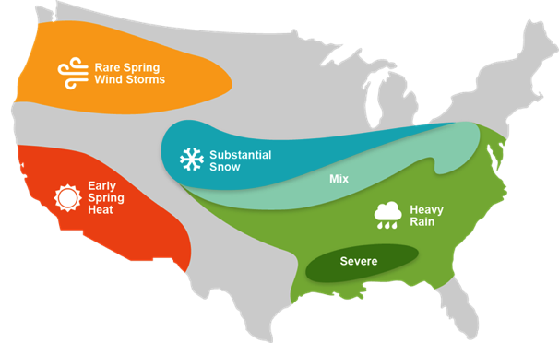
Data Science – Weather Assumptions
Each observation consists
weather conditions
workingday / holiday information
observation extended by derivate variables

Slide 13
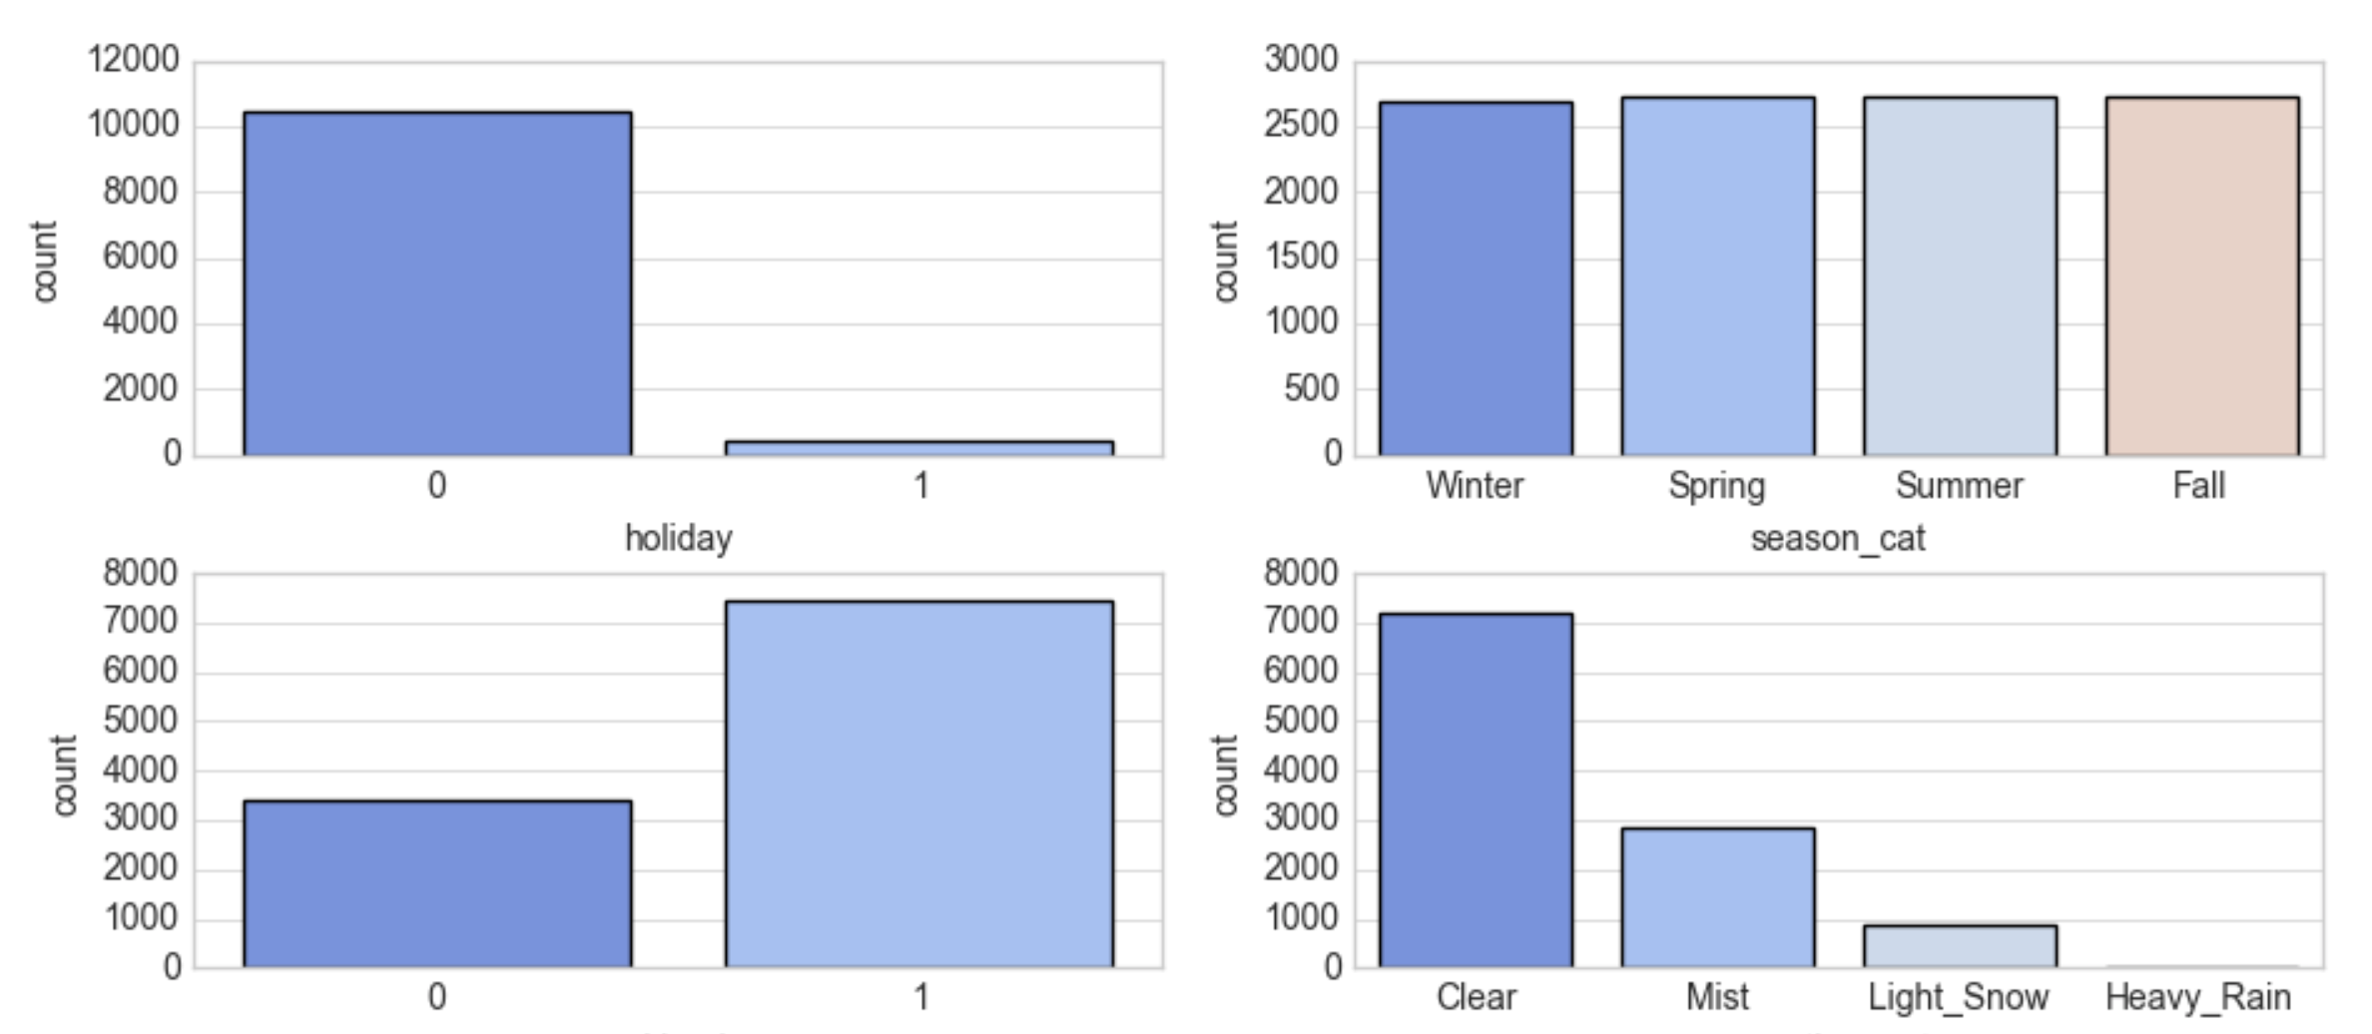
Data Science – Independent variables

Slide 14
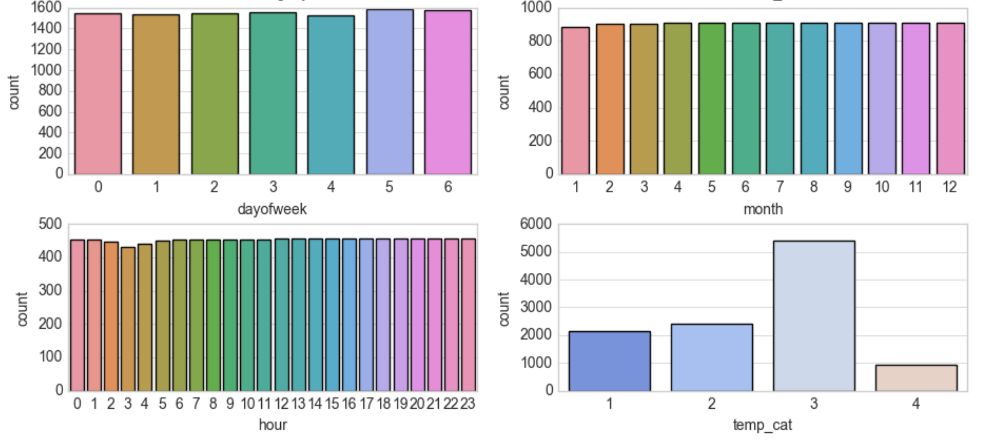
Data Science – Independent variables

Slide 15
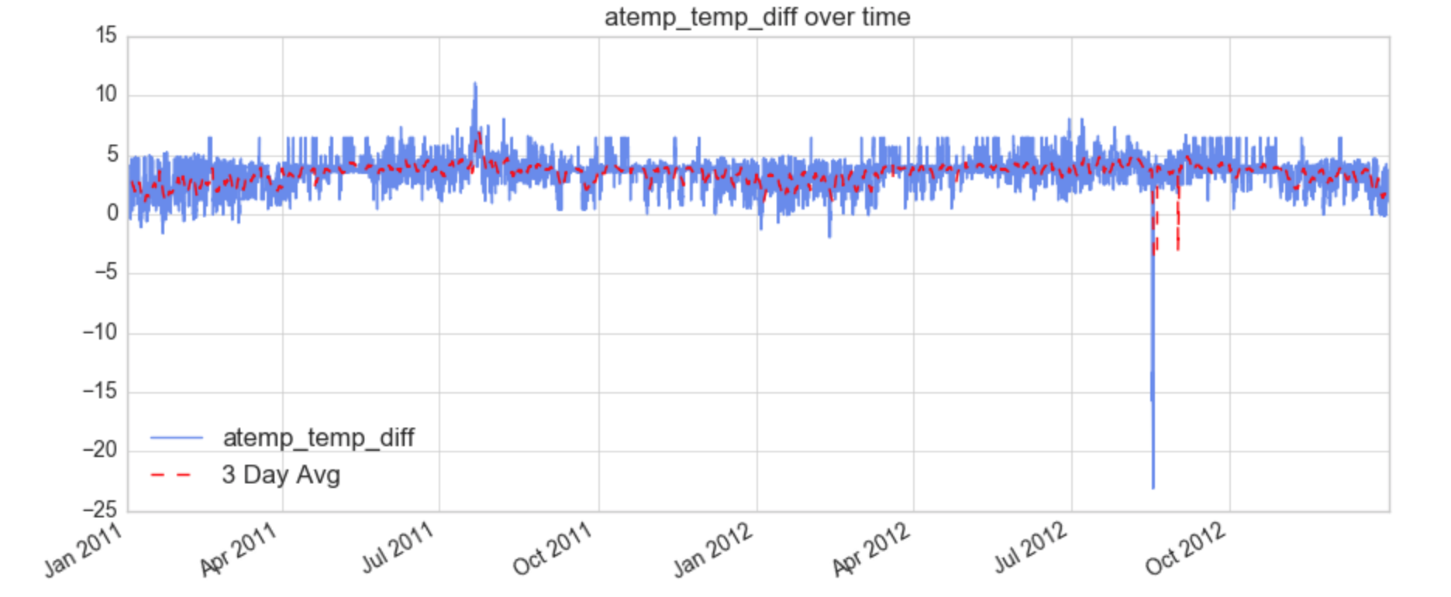
Data Science – Independent variables

Slide 16
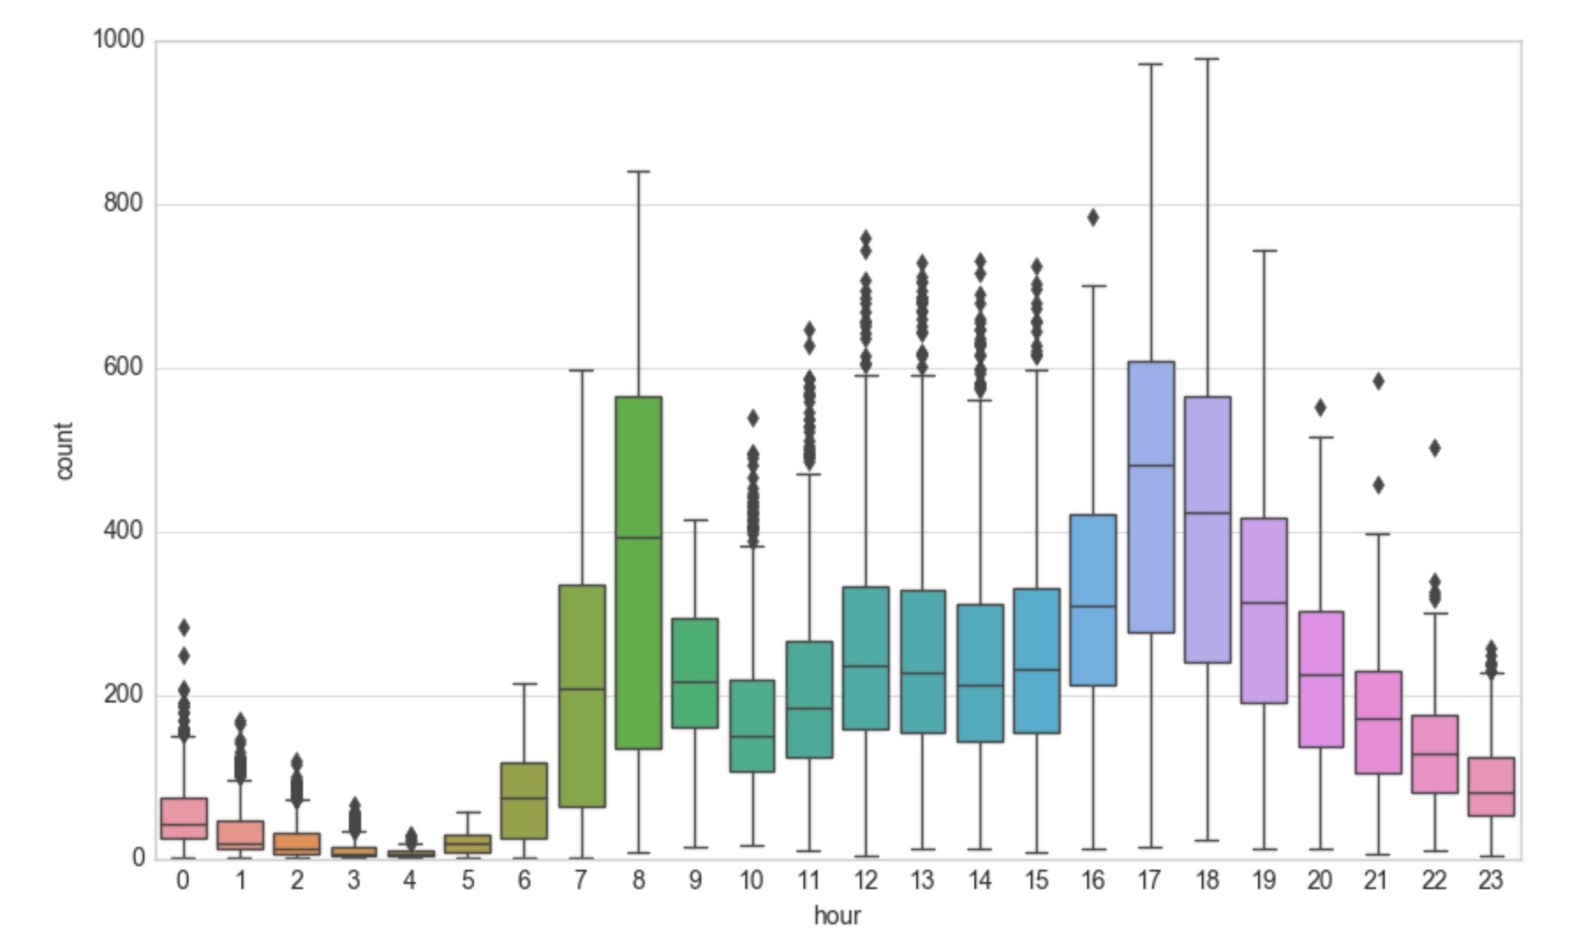
Data Science – Dependent variables

Slide 17
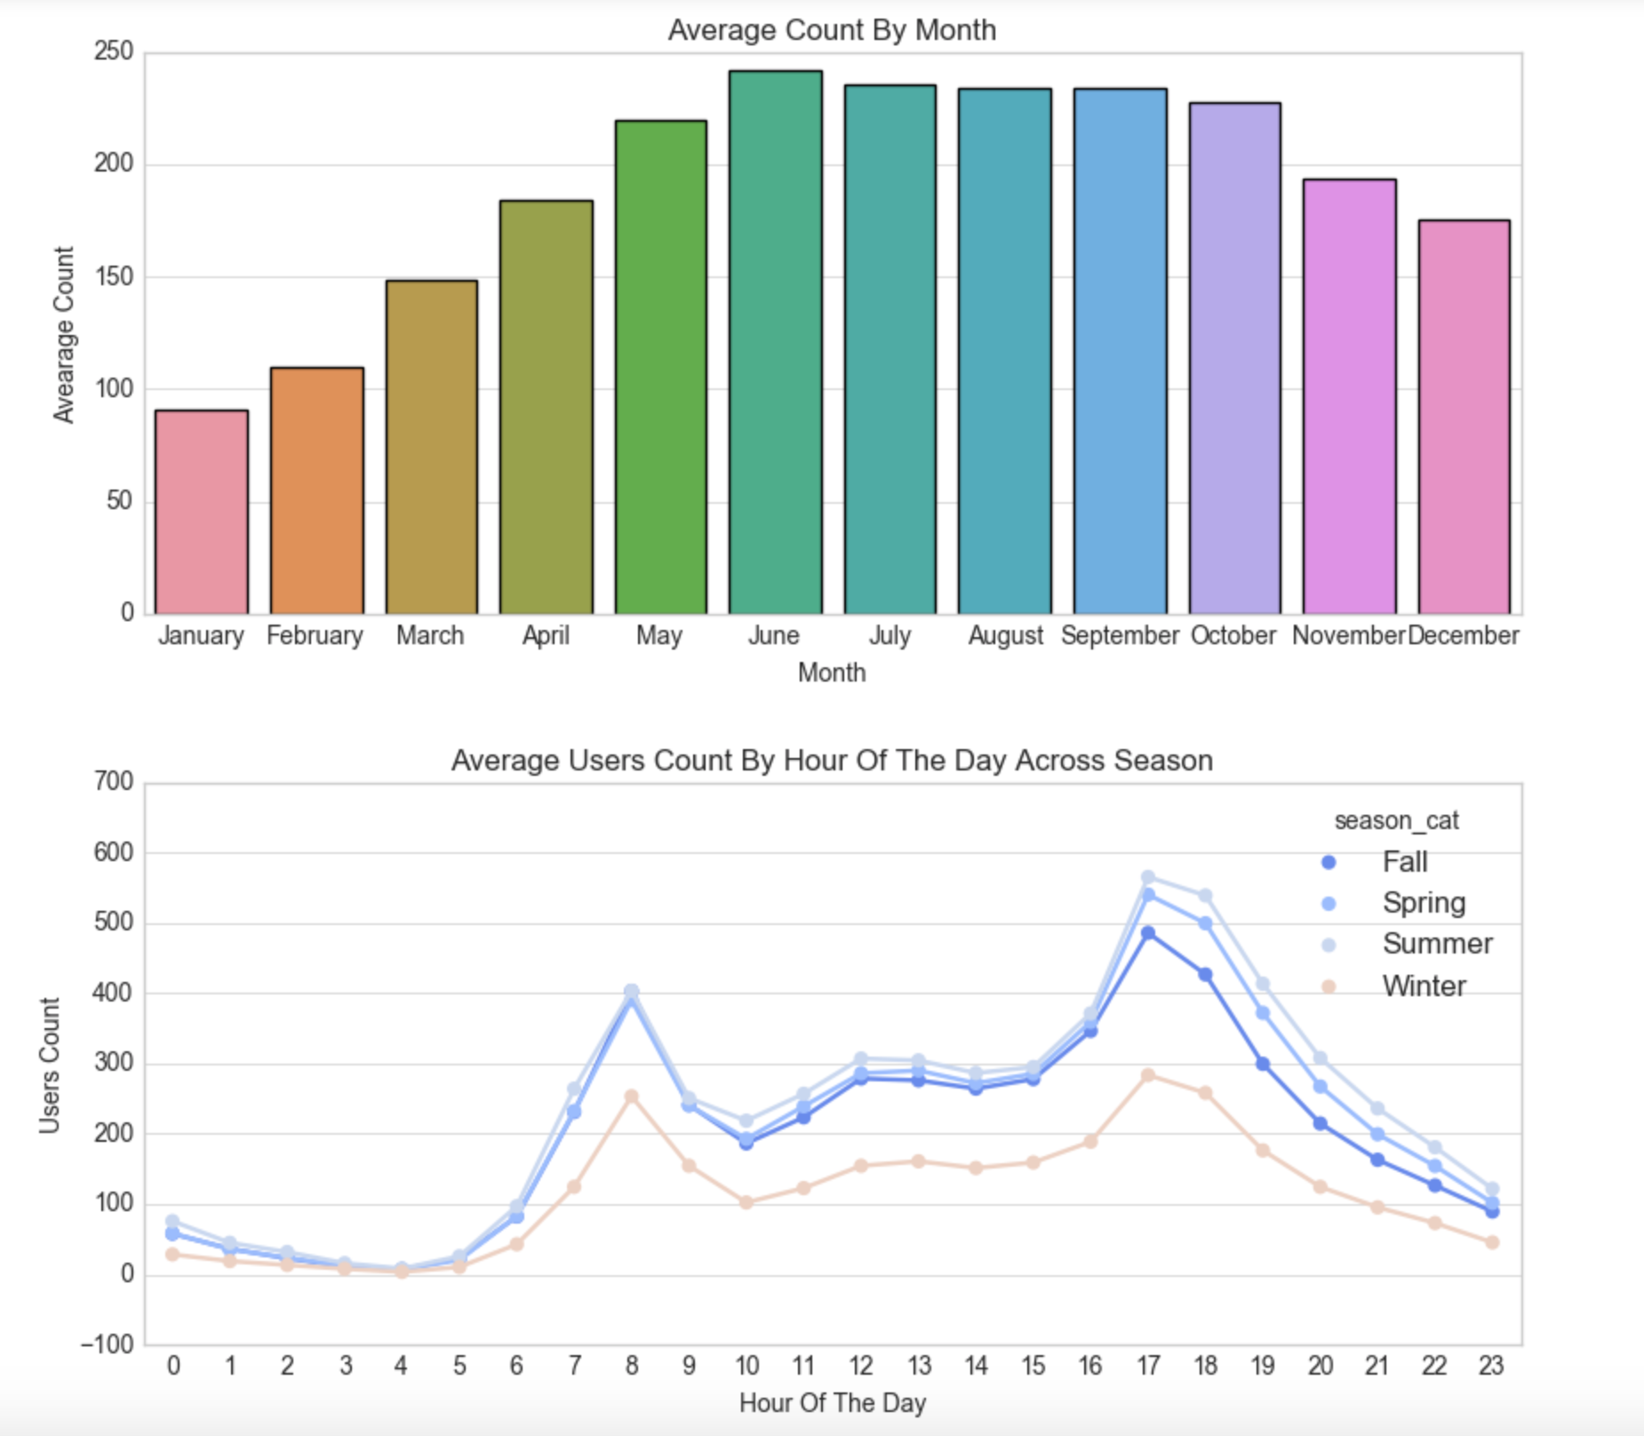
Data Science – Dependent variables

Slide 18
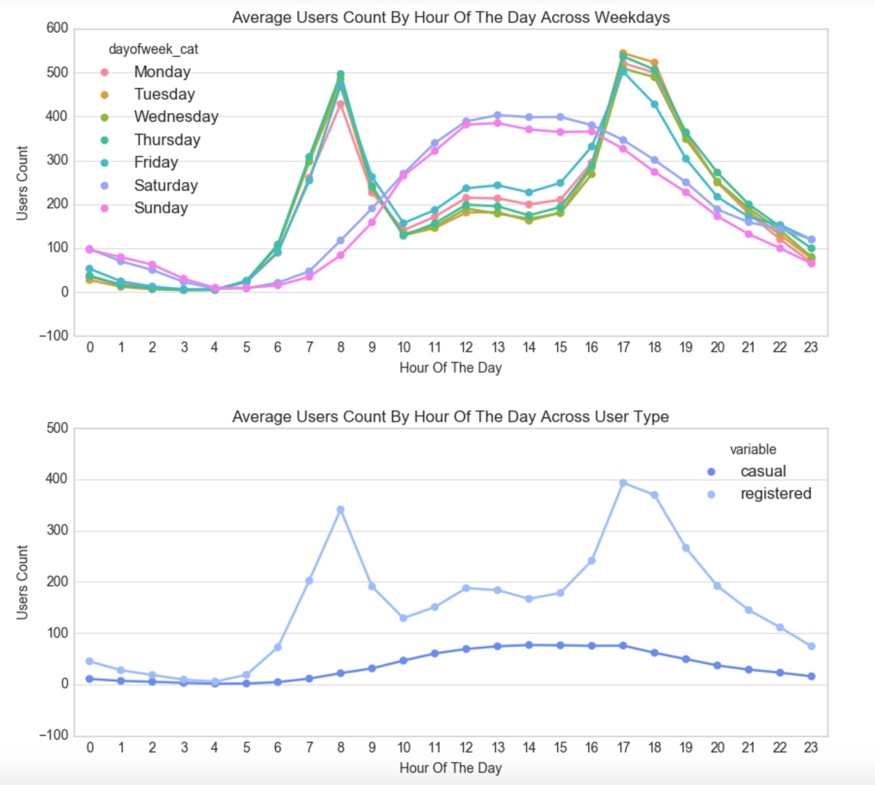
Data Science – Dependent variables

Slide 19
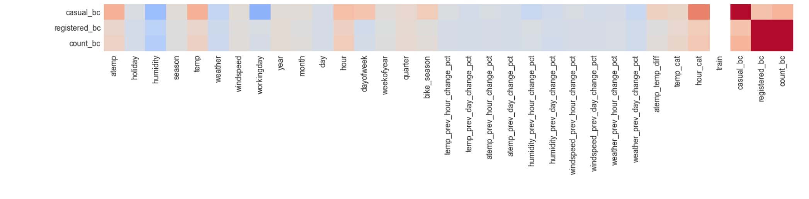
Data Science – Correlations

Slide 20
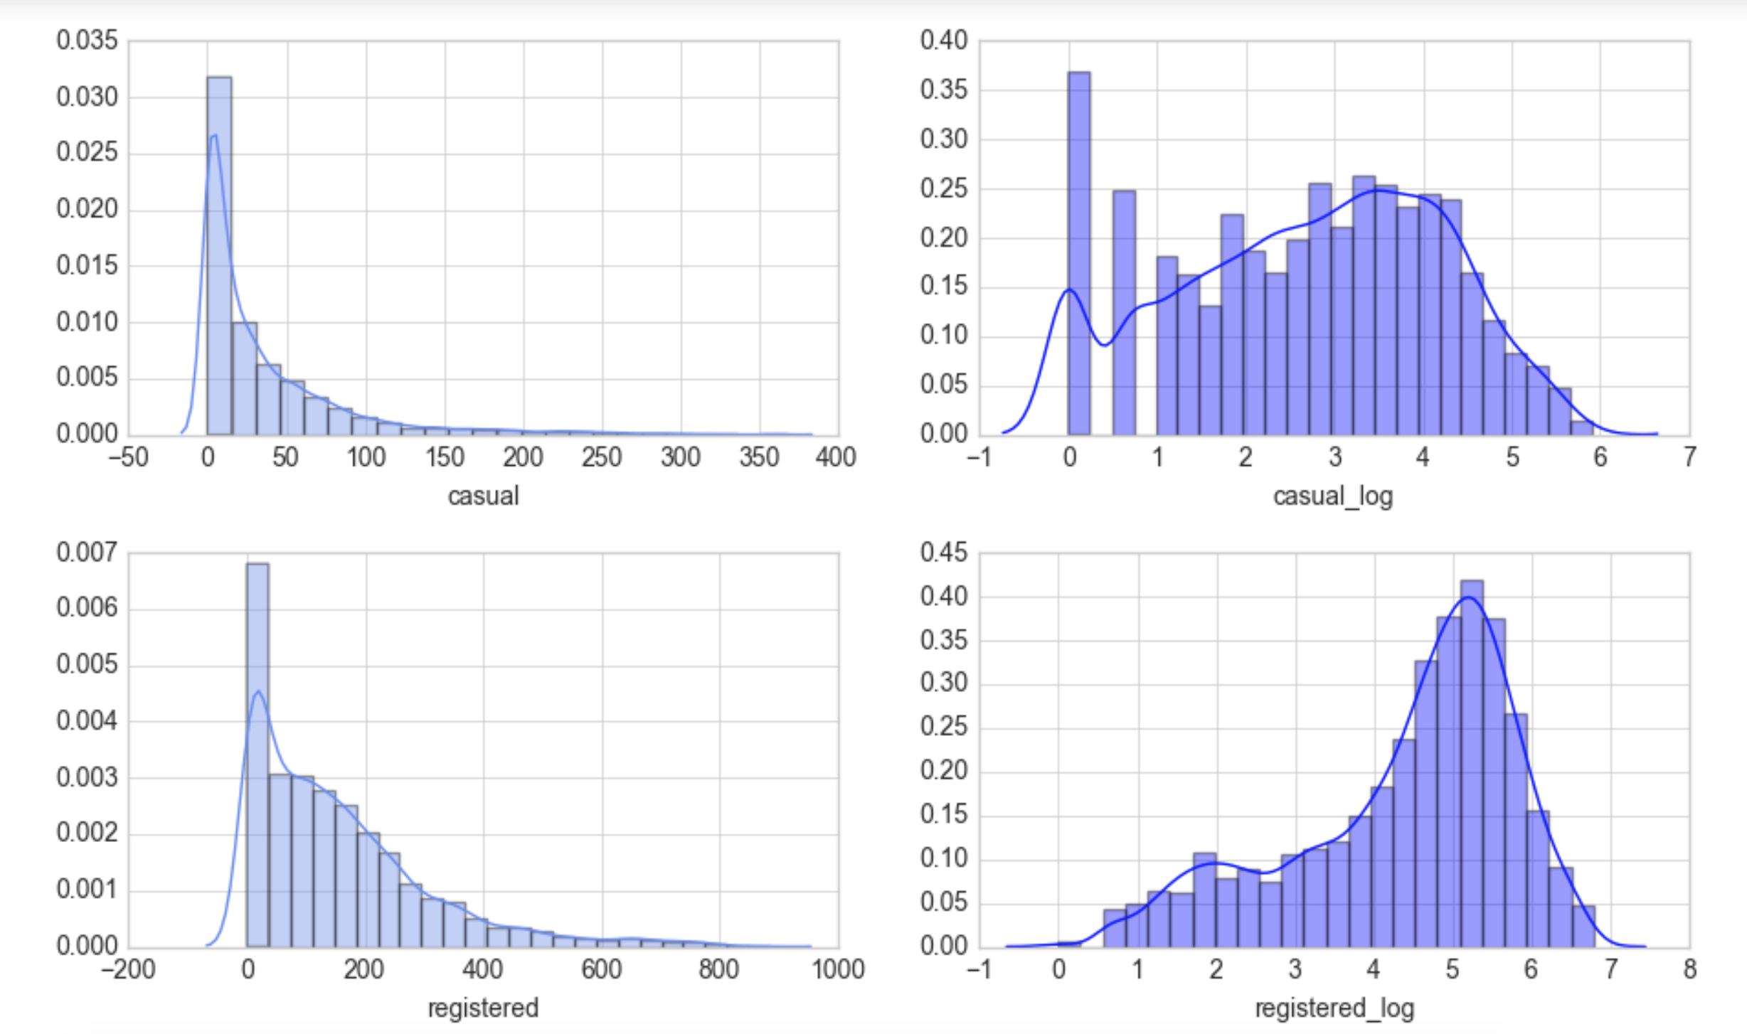
Data Science – Dependent variables

Slide 21
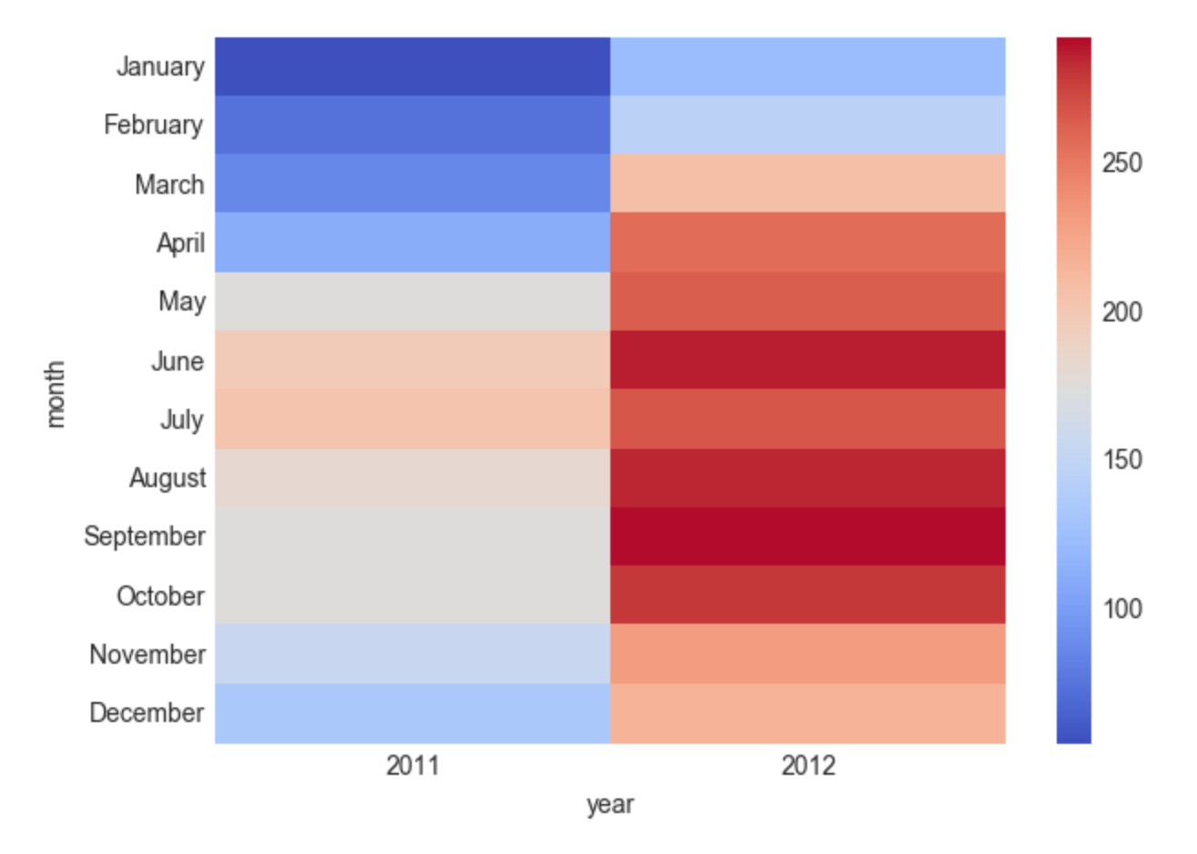
Data Science – Dependent variables

Slide 22
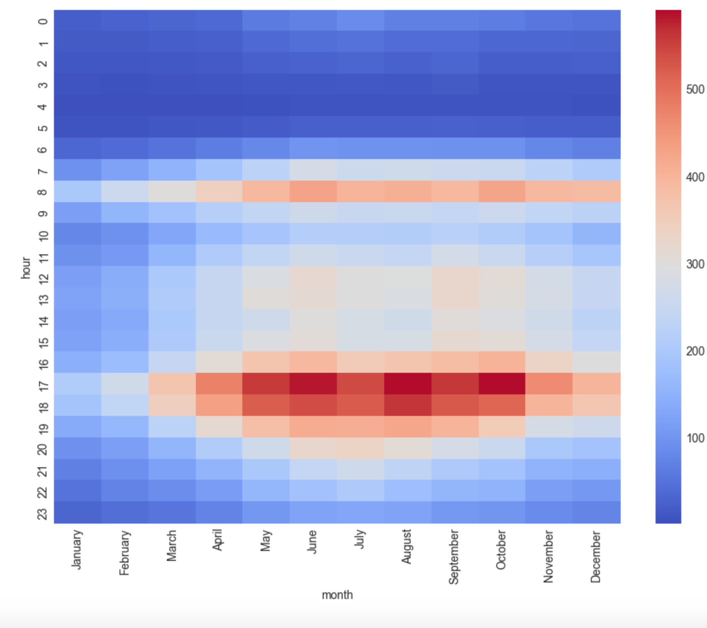
Data Science – Dependent variables

Slide 23
Bike Sharing Demand
How do we make models?
Formal modeling

Slide 24
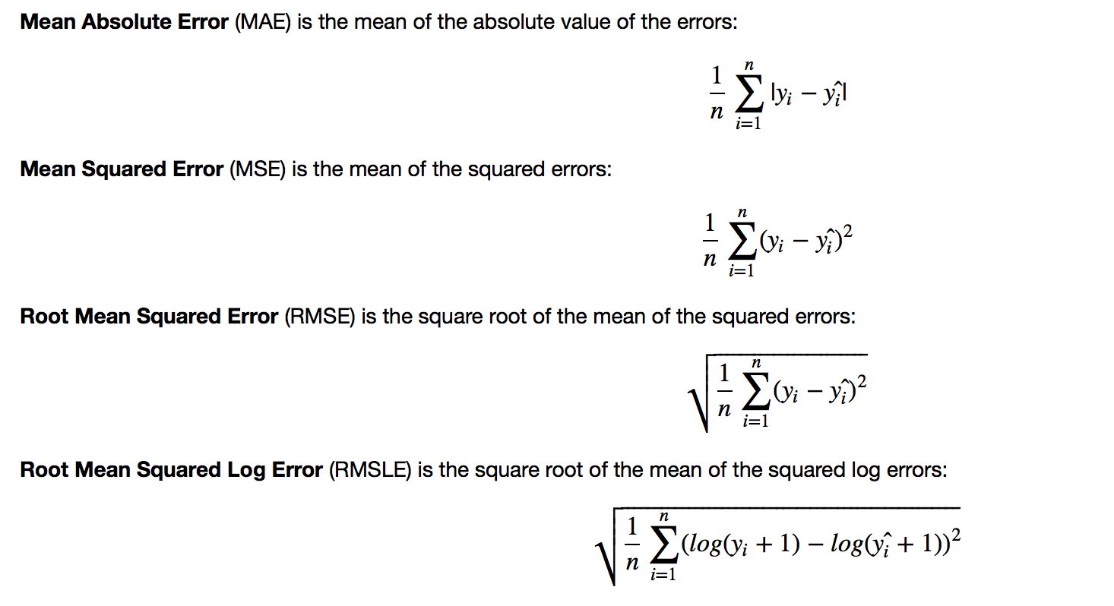
Data Science – Loss Function

Slide 25
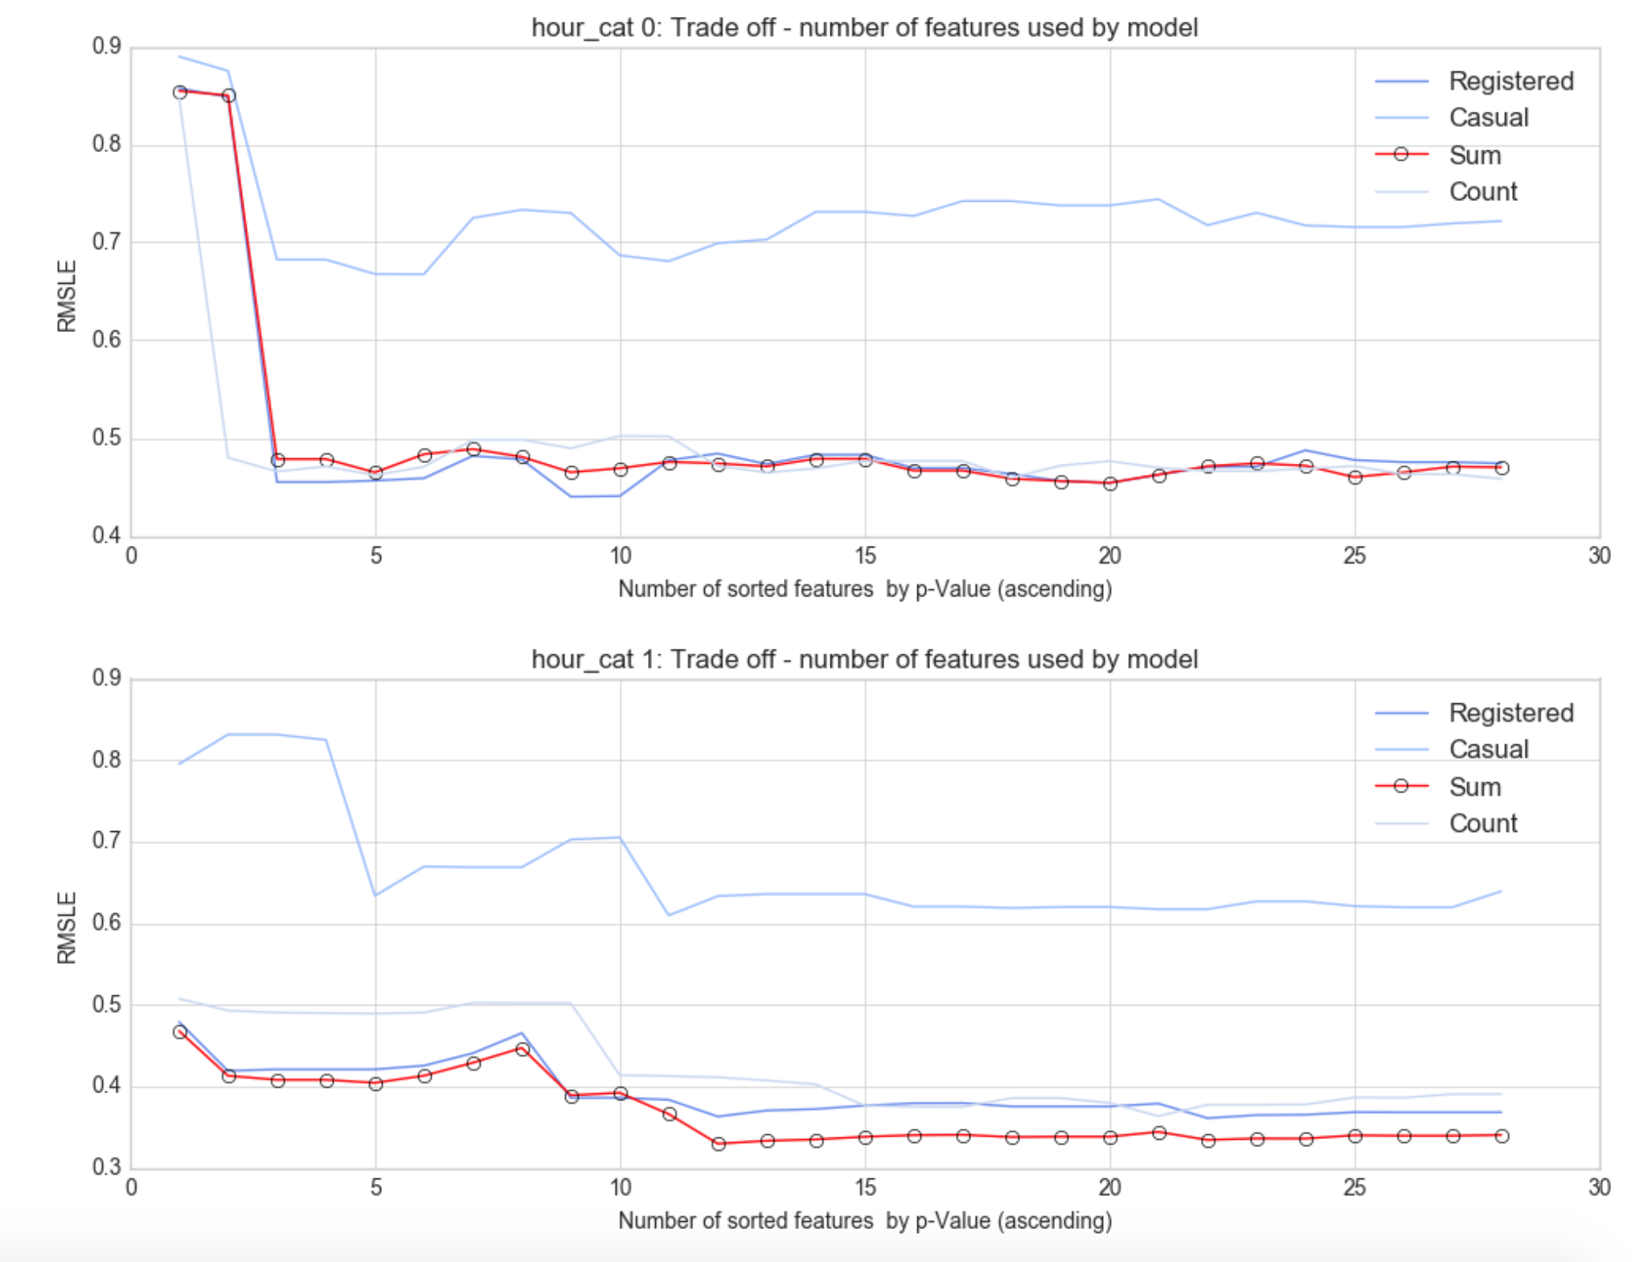
Data Science – Number of features

Slide 26
Bike Sharing Demand
What are the results ?
Interpretation

Slide 27
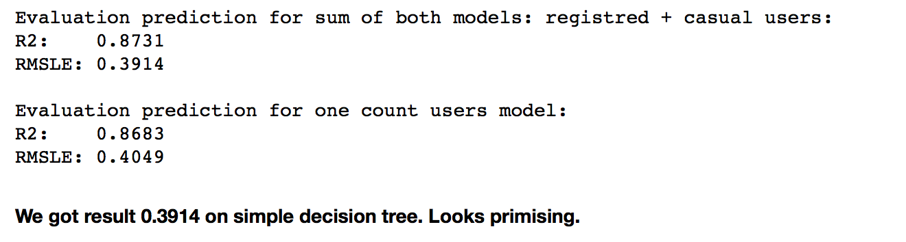
Data Science – One Decision Tree

Slide 28
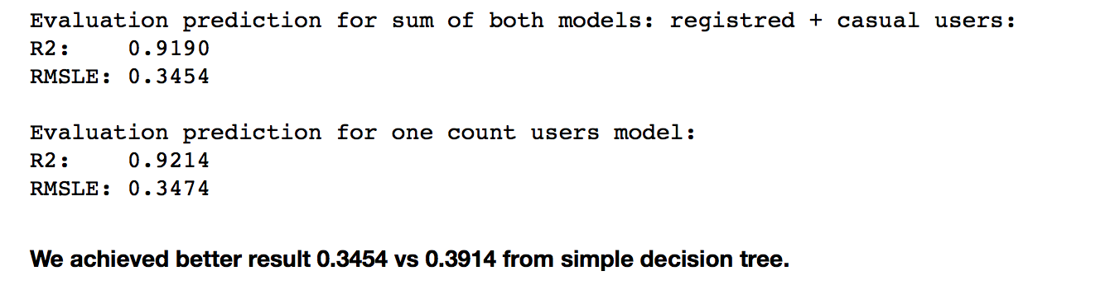
Data Science – Linear Regression

Slide 29
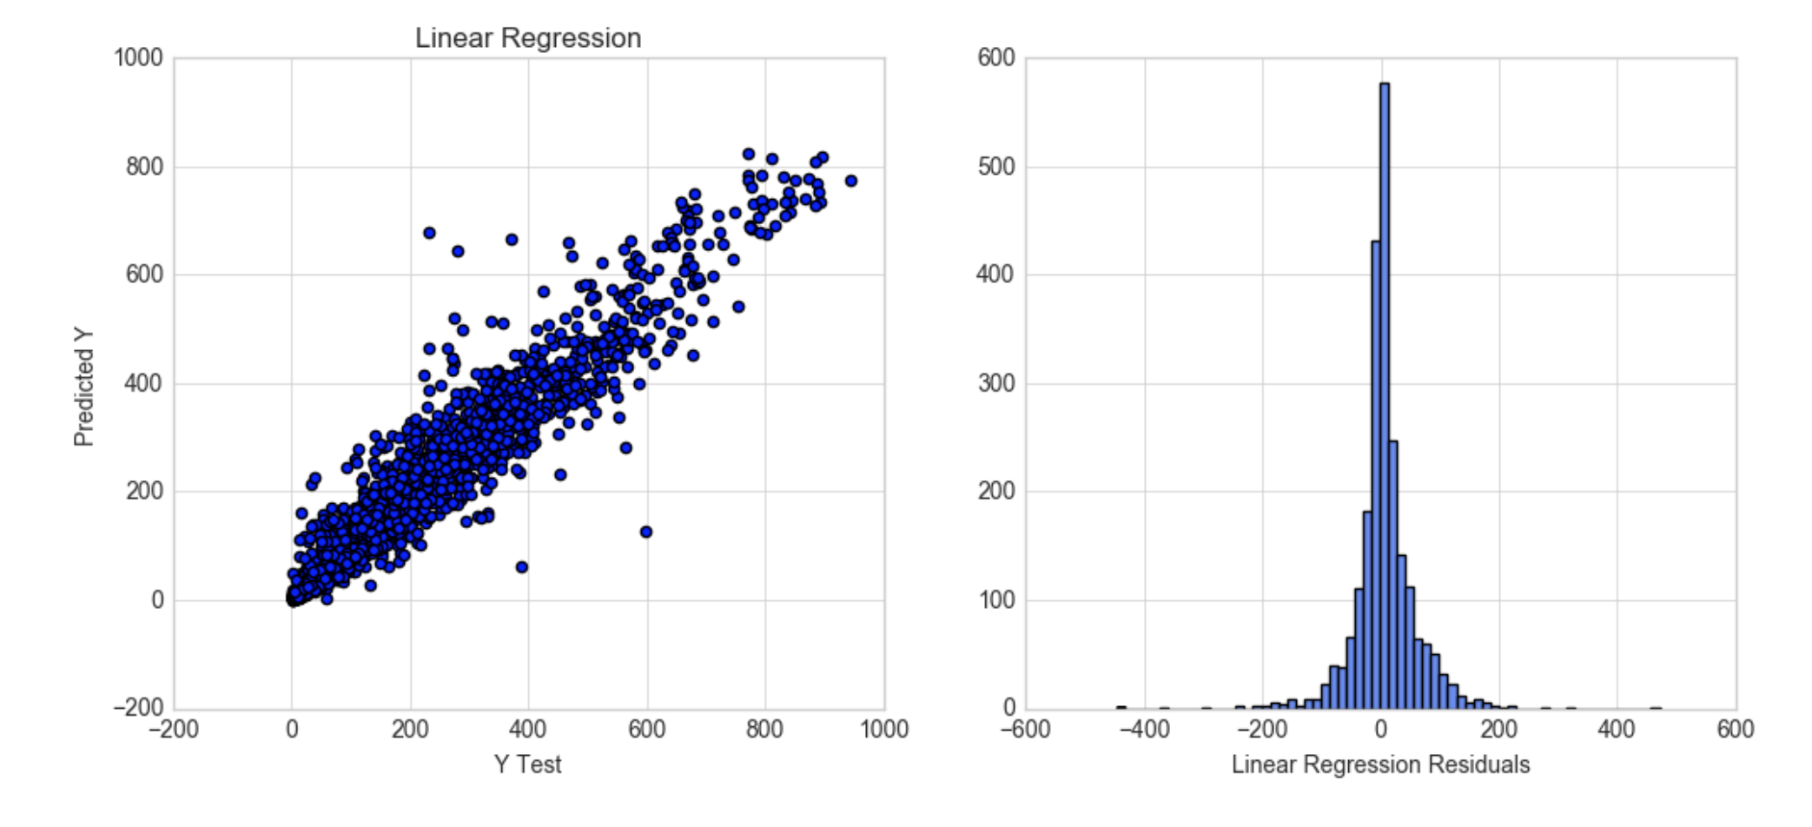
Data Science – Linear Regression

Slide 30
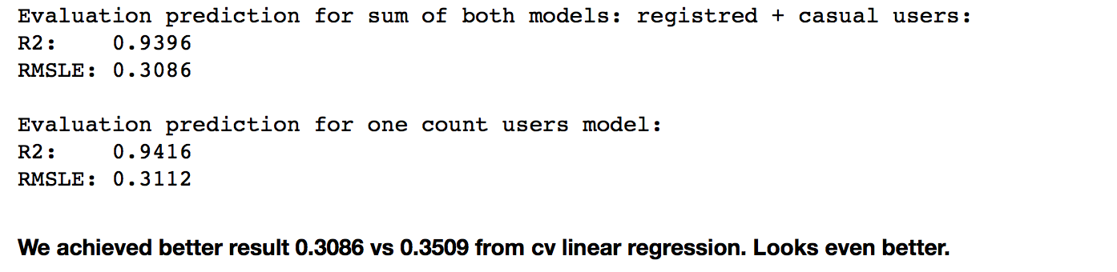
Data Science – Random Forest

Slide 31
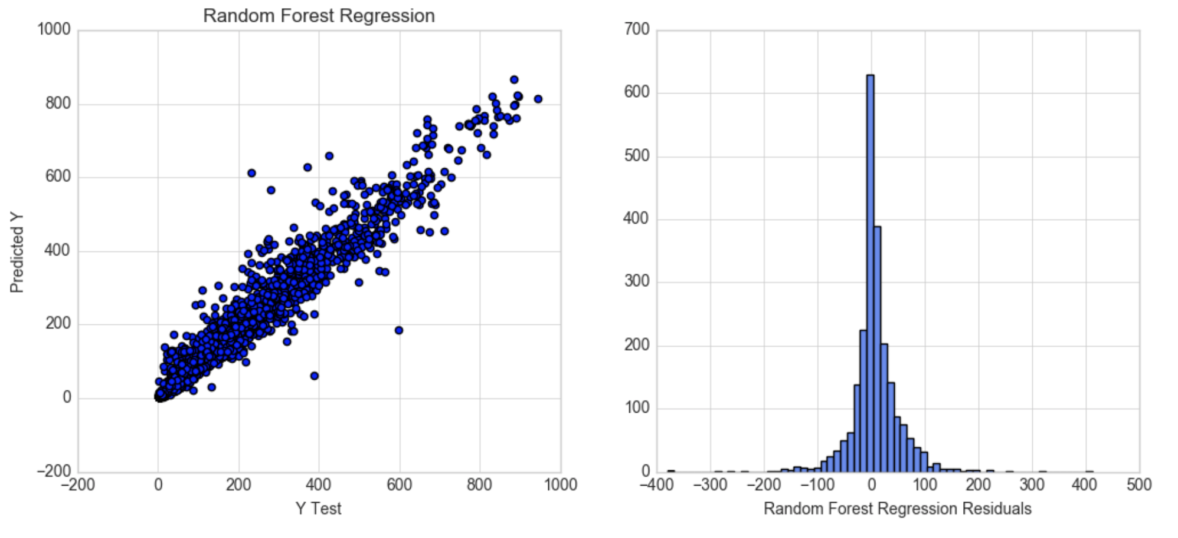
Data Science – Random Forest

Slide 32
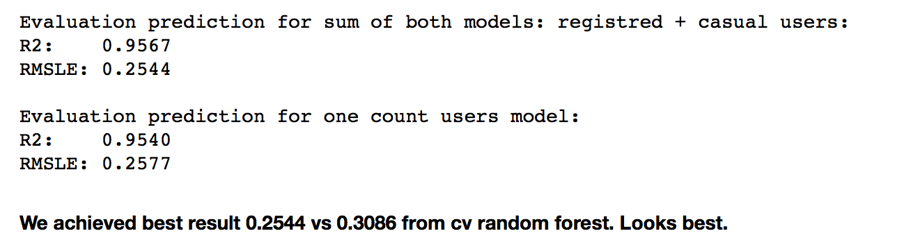
Data Science – Gradient Boosted Tree

Slide 33
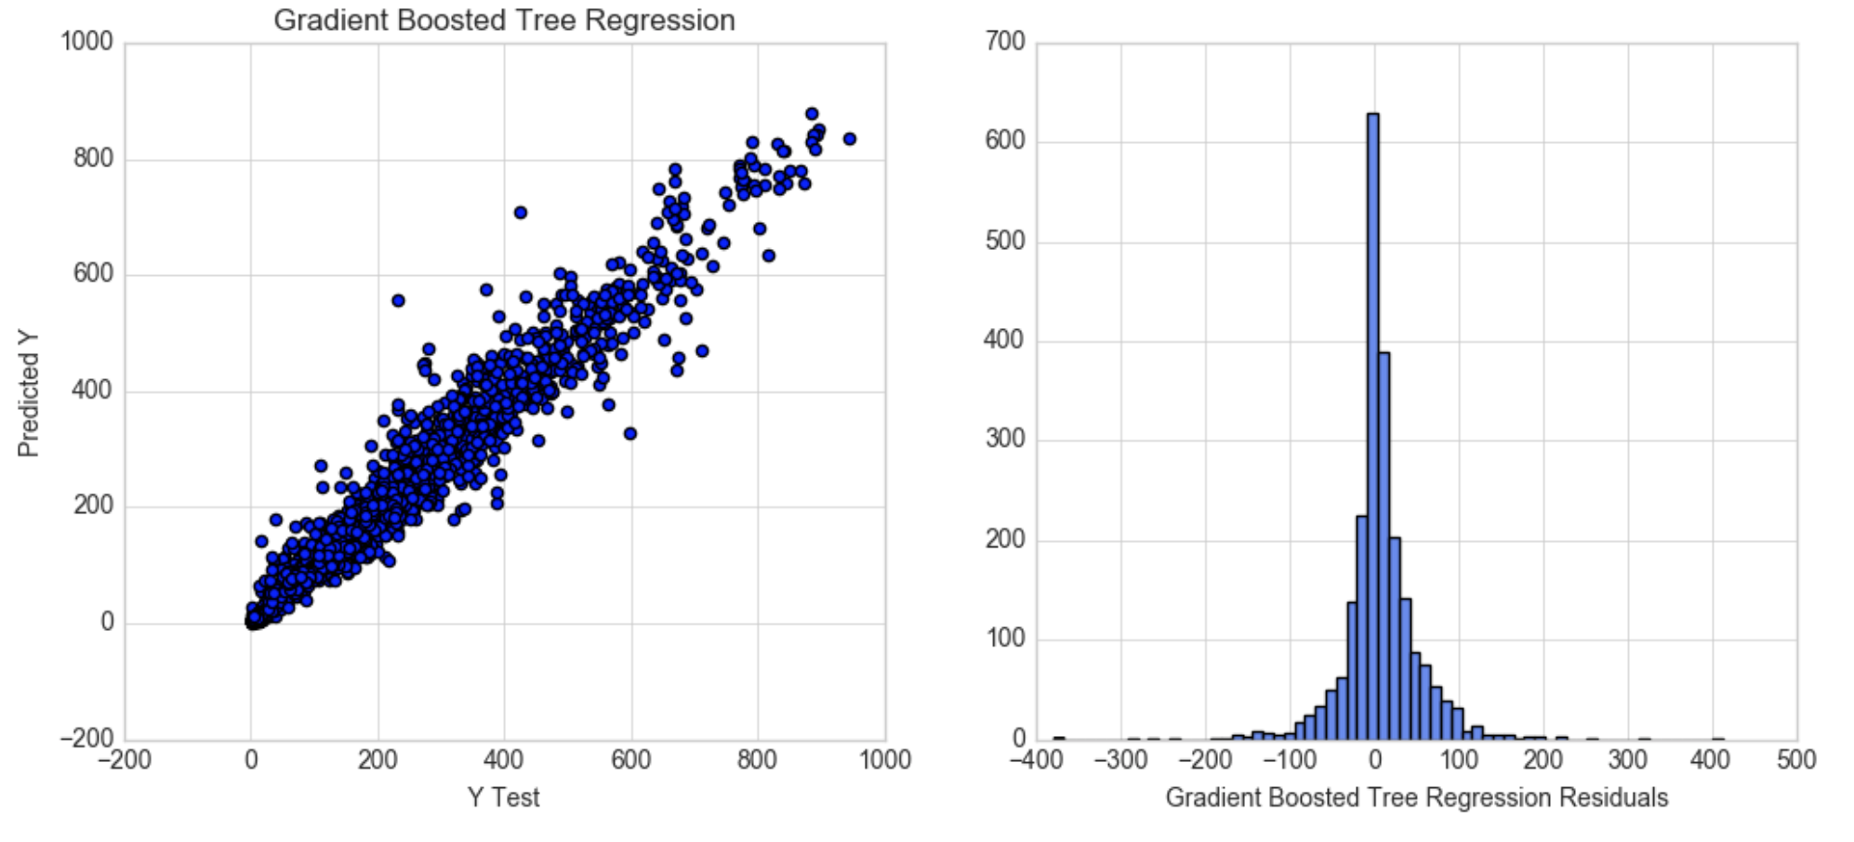
Data Science – Gradient Boosted Tree

Slide 34
Bike Sharing Demand
What are the conclusions ?
Communication

Slide 35
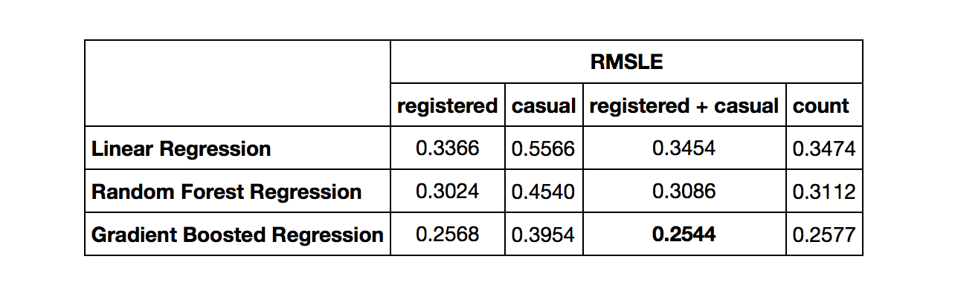
Data Science – Conclusions

Slide 36
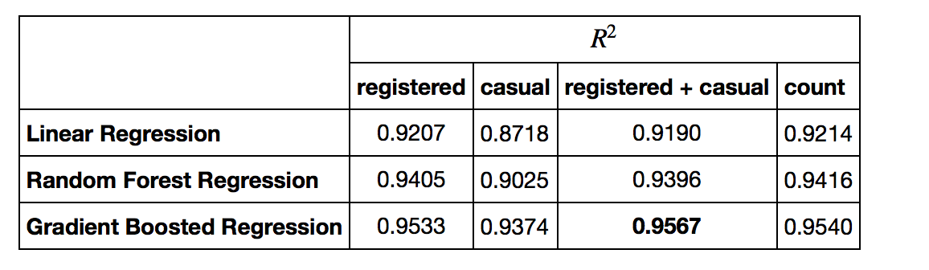
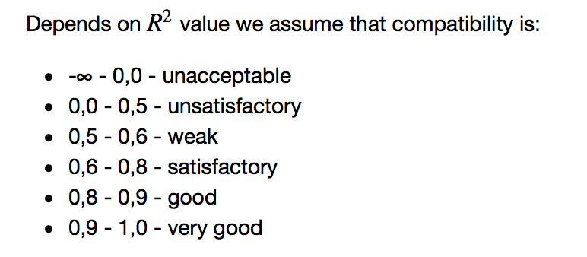
Data Science – Conclusions

Slide 37
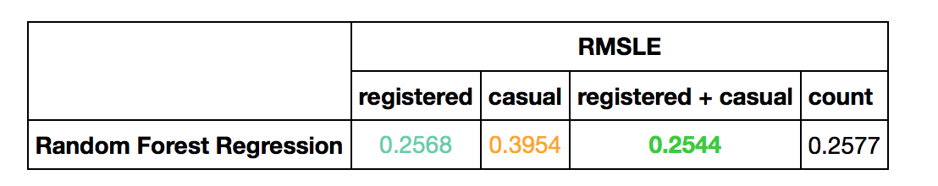
Data Science – Conclusions

Slide 38
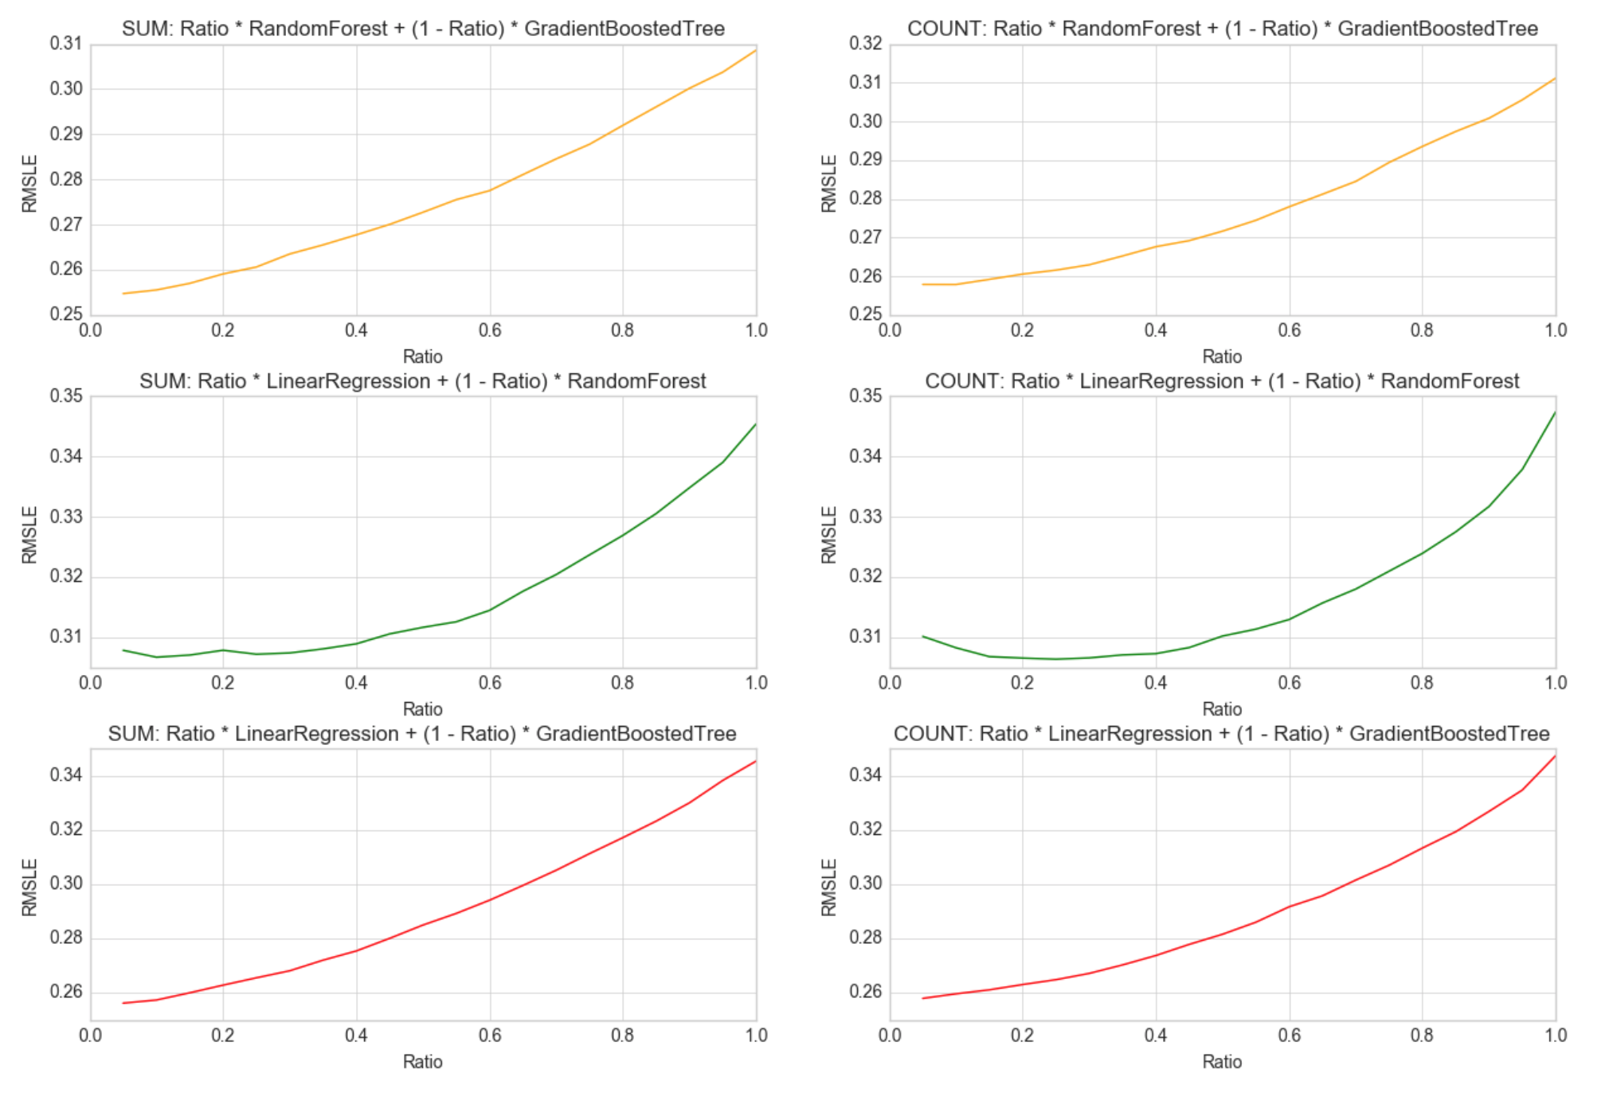
Data Science – Conclusions
Overfitting train data
Looks good
Overfitting train data

Slide 39
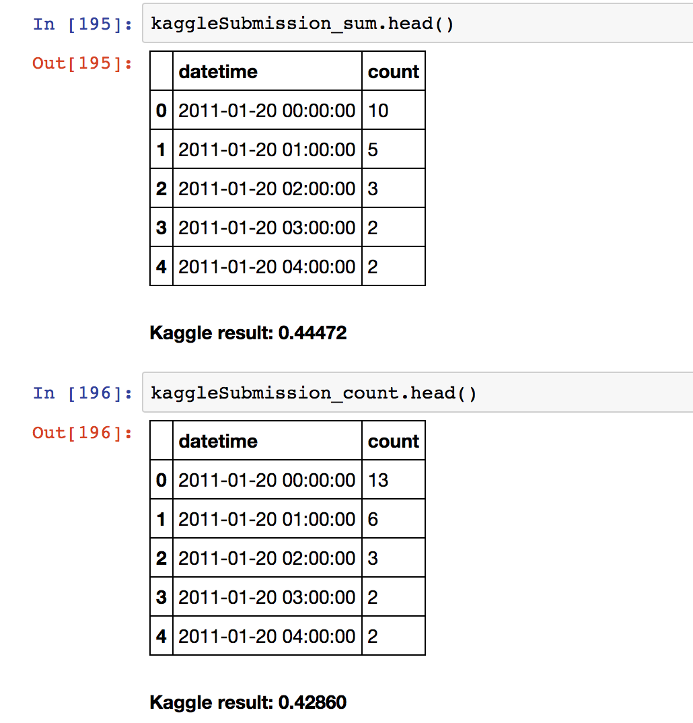
Data Science – Conclusions

Slide 40
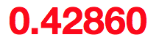
Data Science – Conclusions

Slide 41

Data Science – Future improvements
Tune regularization of Gradient Boosted Tree Regression models to deal with overfitting.
Take a close look on predicted outliers (clearly seen on scatter plots with predictions vs labels).
Make more / less hour categories and more separate models to better minimize RMSLE for hours with very few bike rentals. RMSLE metric hurts relatively more when the numbers are smaller.
Make PCA analysis to reduce number of features
Use another regression models like Deep Neural Networks for regression

Slide 42
Bike Sharing Demand
THANK YOU !
Artur Suchocki

